Slide 1
Hack Club Stardance Challenge
June 1 - October 31, 2026 · in partnership with NASA
Impact Report for Challenger Center
Data as of November 5, 2026
Notes:
Recap of the Stardance Challenge for Mike Kincaid, Mamta Patel Nagaraja and Simone Soso, Challenger Center. Numbers are from the Hack Club data warehouse as of November 5, 2026. Sign-ups stay open on the site, so the counts keep moving slightly.

Slide 2
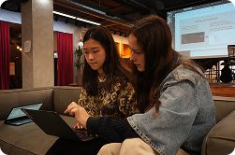
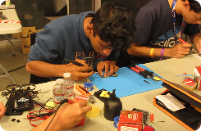
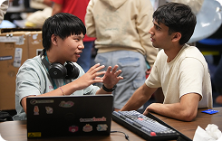
The Stardance Challenge was one of the biggest high school engineering challenges in American history
71,257 teenagers (ages 13-18) signed up, 22,098 of which are American, from all 50 states and DC; the rest came from 180+ countries and territories around the world.
61,555 projects created, and 7,375 projects shipped publicly, each with a working demo and an open-source repo.
168,264 hours of tracked engineering time on projects (that’s 19.2 years of nonstop making)!
59,725 public build logs and 73,275 peer reviews. In the Stardance Challenge, teenagers reviewed other teenagers’ work and gave feedback on the projects that shipped!
Notes:
Sign-ups: 71,257 total, 22,098 in the US (50 states + DC), 184 country codes. Projects and hours: non-deleted projects in the Stardance app. Shipped = projects with at least one ship event (4,029 teens shipped). Build logs and peer reviews are from the app.

Slide 3
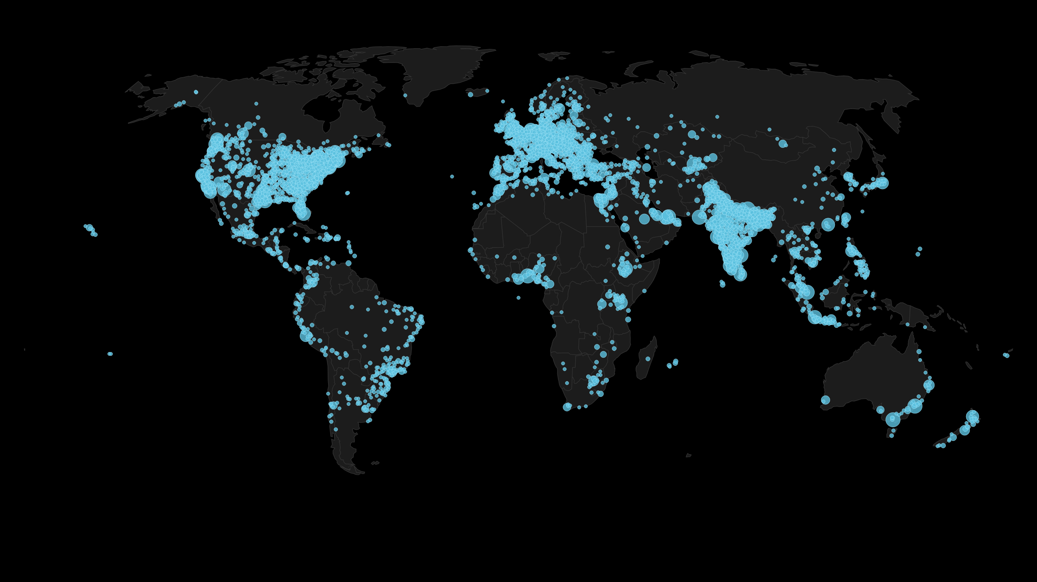
71,257 teens from around the world signed up for the Stardance Challenge.
Notes:
Dots are 0.5-degree grid cells of sign-ups, placed from the approximate location recorded at sign-up.

Slide 4
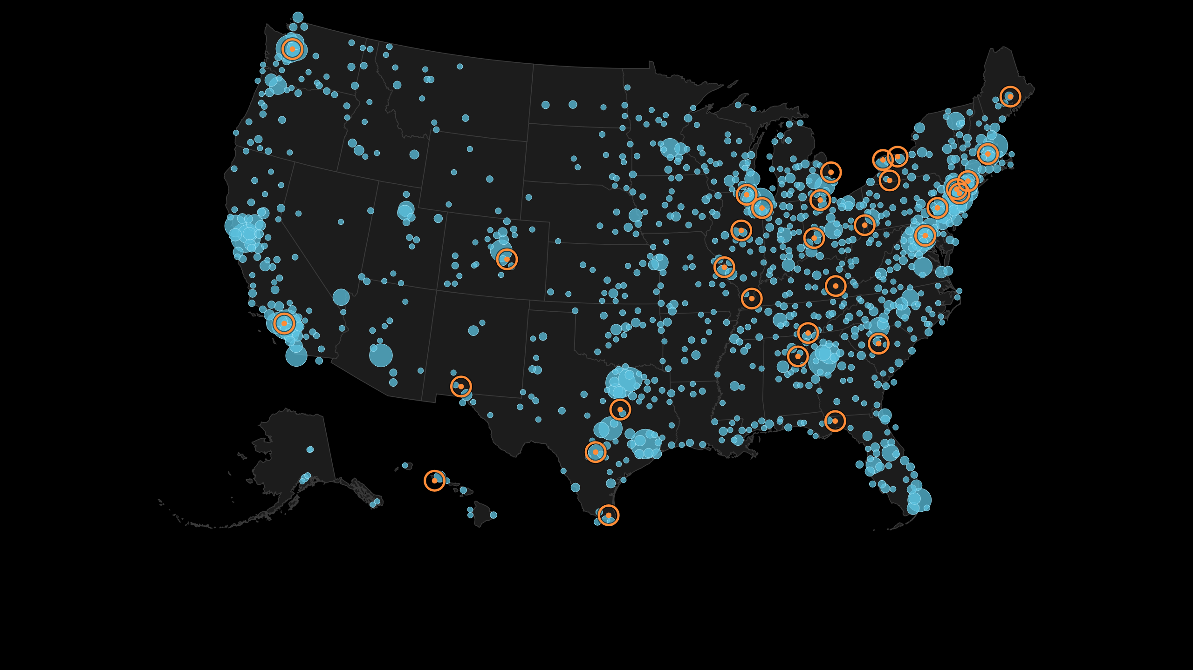
22,098 American teenagers from all 50 states + DC signed up
About 10,000 of them live within 50 miles of a Challenger Learning Center (orange rings)
Notes:
Orange rings are the 32 Challenger Learning Centers in the US listed on challenger.org. 10,090 of the 22,098 US sign-ups (46%) are within 50 miles of one, and 6,996 are within 25 miles, based on the approximate location recorded at sign-up. Largest clusters: New York City and Paramus, Downey (Los Angeles), Maryland, Seattle, Northwest Indiana and Framingham.

Slide 5
81% of the teenagers who shipped a project in Stardance had never shipped with Hack Club before.
Teenagers who built during Stardance spent 2.7× more time per week making projects than in the three months before it
Notes:
4,029 teens shipped at least one Stardance project; 3,271 of them (81%) had no earlier approved project in any Hack Club program and no earlier ship in Flavortown. Hours per week: tracked coding time for the 8,076 teens who logged time on a Stardance project, March 1 - May 31 (3,905 hours a week) versus June 1 - October 31 (10,641 hours a week).

Slide 6

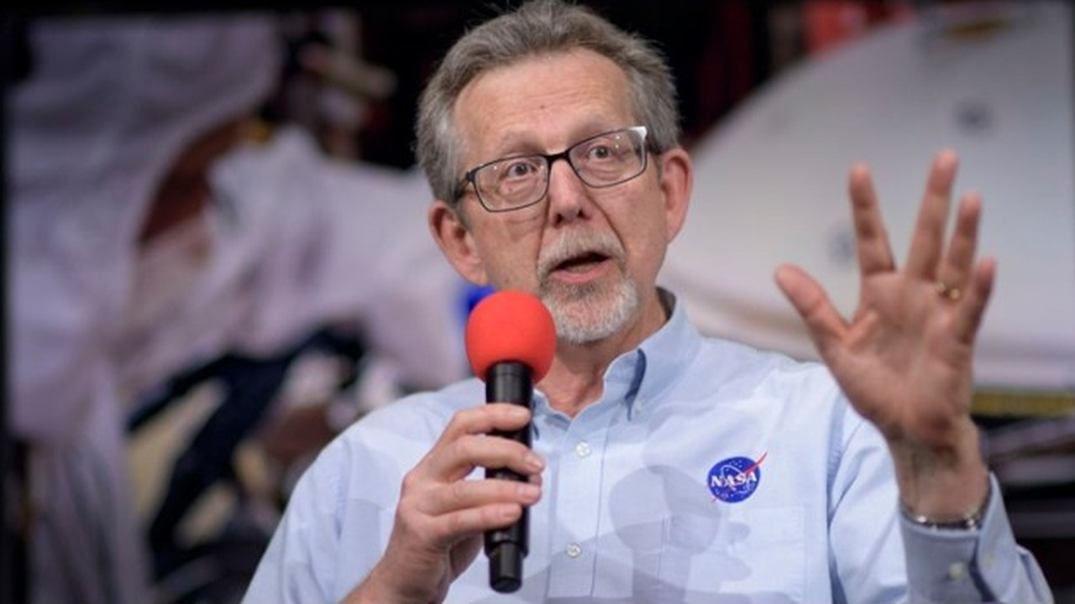

How Challenger Center and Hack Club worked together to inspire the next generation of explorers
Two partnership agreements: the first signed in December 2025, the second for Stardance in June 2026.
January 30: together we launched Hack Club’s first-ever space challenge, inside our winter program, Flavortown. Teens submitted 211 projects.
April 18: Dr. Jim Green, NASA’s former Chief Scientist, took teens’ questions live. “oh my god that was the coolest ama ever,” one wrote. Another: “hc should have a whole NASA AMA series.” This summer, Stardance had one.
June 1: the Stardance launch emails, sent to about 3.2 million students, named Challenger Center alongside NASA and Kennedy Space Center for “once-in-a-lifetime prizes that money can’t buy,” including the chance to meet an astronaut.
stardance.hackclub.com has listed Challenger Center with NASA, AMD and GitHub in its partner section since launch.
September 15: Dr. Mamta Patel Nagaraja, NASA’s former Associate Chief Scientist, answered teens’ questions live for an hour. The recording is on Hack Club’s YouTube channel.
Behind the scenes: Mike and Mamta’s advice on working with NASA, starting with our planning call in March, helped shape the challenge.
Stardance AMA: Dr. Mamta Patel Nagaraja, Sep 15
Hack Club AMA: Dr. Jim Green, April 18
Partner section of stardance.hackclub.com
Notes:
Space challenge: 211 projects were submitted to the Challenger Center challenge inside Flavortown (January 30 - May 1, 2026). “Hack Club’s first-ever space category” is Challenger Center’s wording from its January 30 press release. The launch email wording is quoted from the June 1 email. The partner section has carried Challenger Center’s logo since May 31. AMA recordings: youtu.be/BvzS-okL7vo (Dr. Jim Green) and youtu.be/MVrcOMkCpXc (Dr. Mamta Patel Nagaraja).

Slide 7
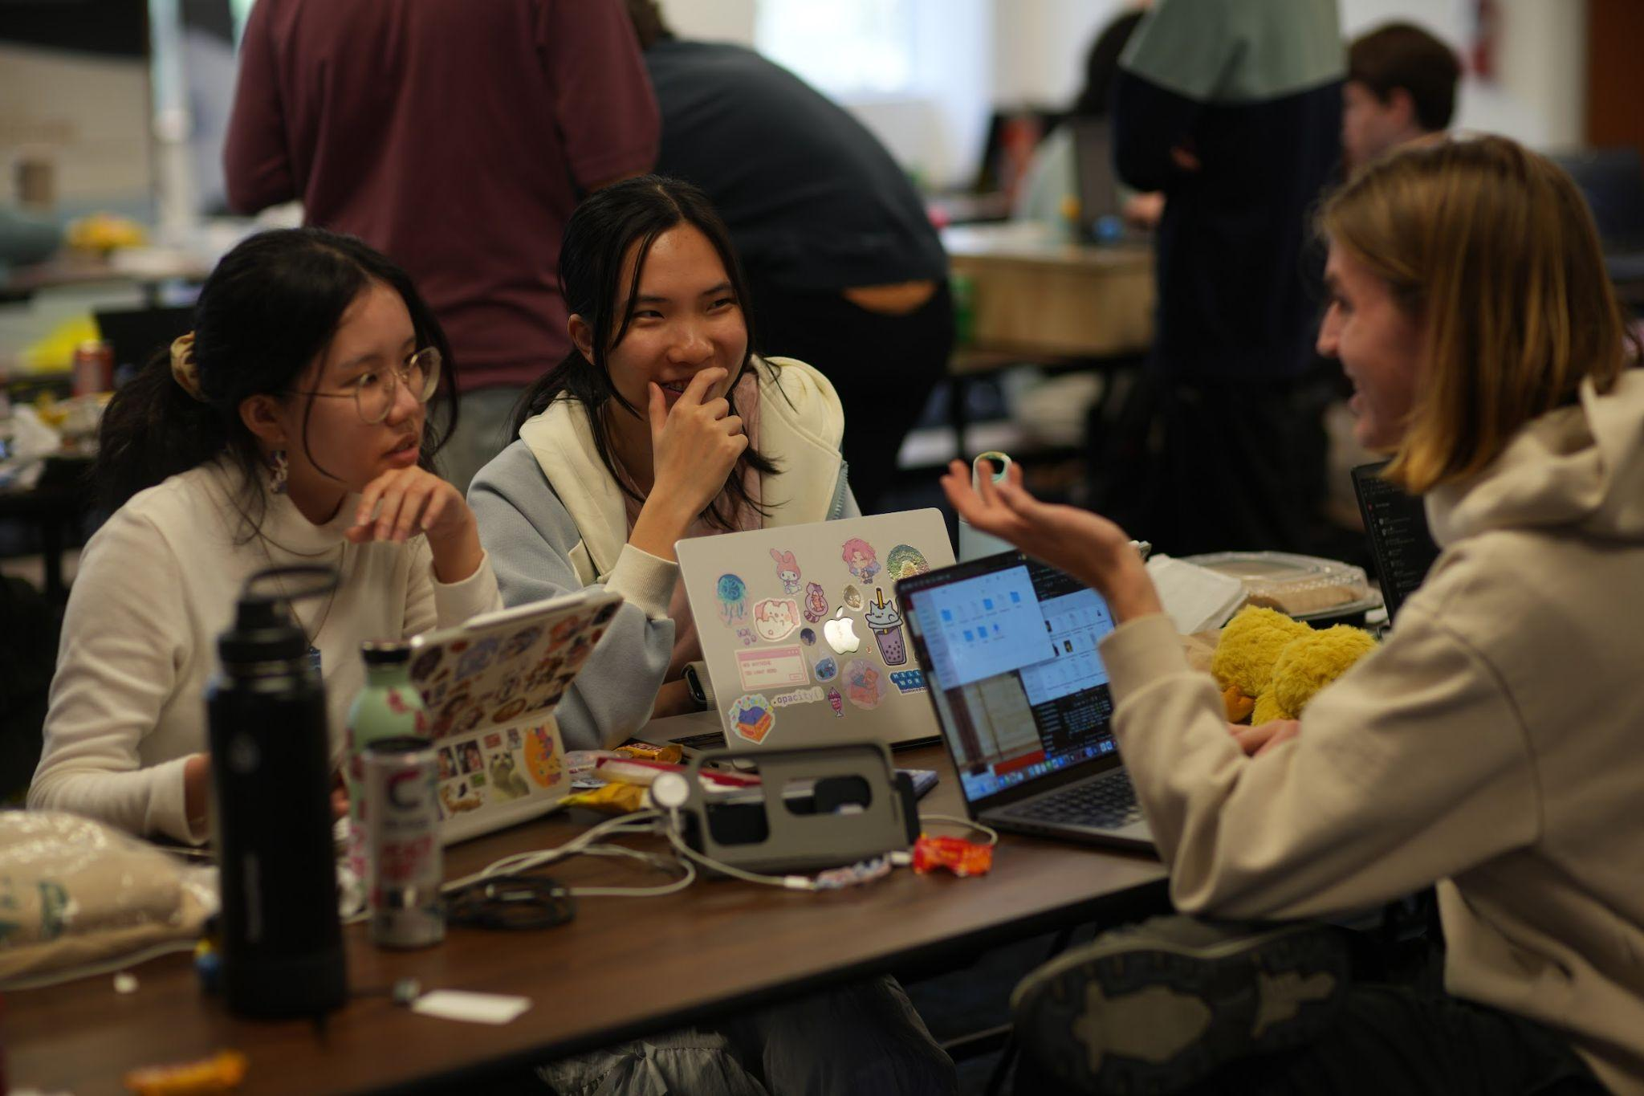
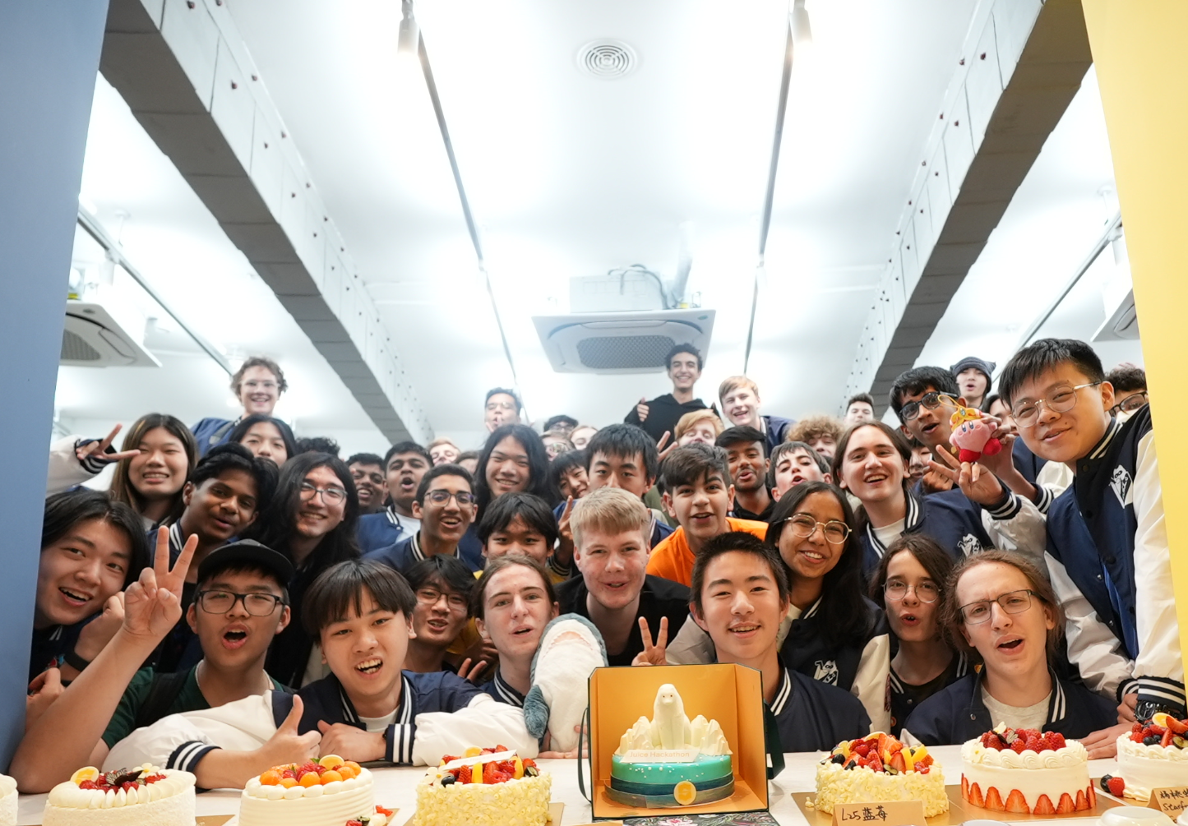
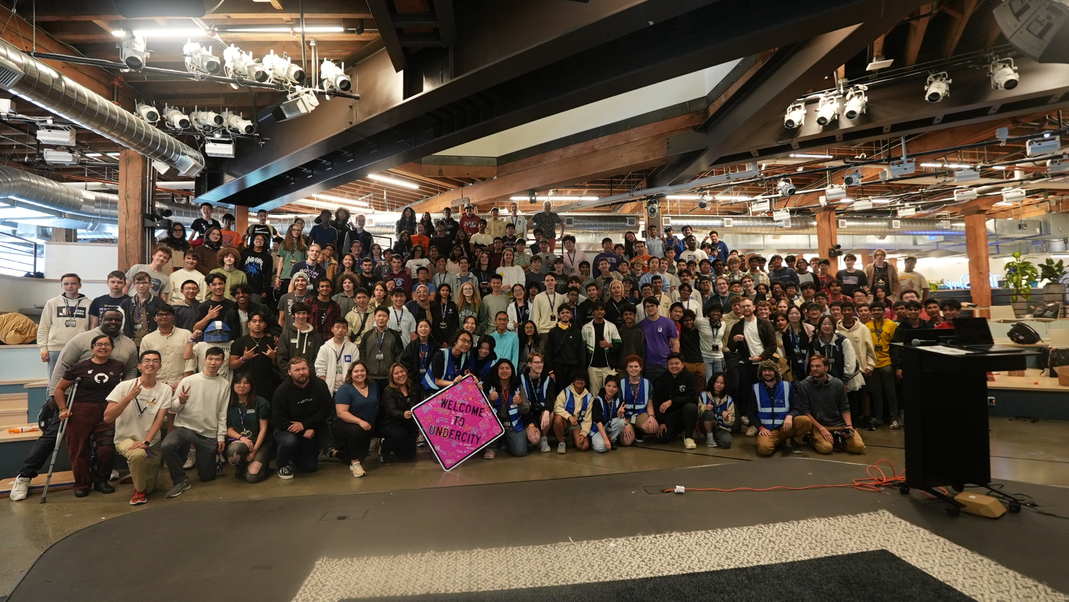
Challenger Center’s target student outcomes | What Hack Club’s Stardance Challenge delivered
STEM Career Awareness: “Increase student awareness of STEM careers” | Live Q&As with NASA’s Administrator, a NASA flight director and Dr. Mamta Patel Nagaraja, plus answers from the ISS by astronaut Anil Menon.
STEM Identity: “Develop students’ sense of belonging in STEM” | 59,725 public build logs and 73,275 peer reviews: teens sharing their work with, and getting feedback from, other teens who build.
STEM Engagement: “Develop student engagement in STEM” | 71,257 teens signed up, 77% of them new to Hack Club. 8,076 logged 168,264 hours of engineering, at 2.7× their weekly pace before Stardance.
STEM Self-Efficacy: “Develop students’ feeling that they can ‘do STEM’” | 7,375 projects shipped publicly. 81% of teens who shipped had never shipped with Hack Club before; 62% of sign-ups had little or no coding experience.
21st Century and Social-Emotional Learning Skills: “Develop student communication, collaboration, and problem-solving abilities” | Each shipped project needed a working demo and an open-source repo, then went to other teens for review. 15,900 hardware projects, backed by 1,545 micro grants.
Notes:
Left column: the five student outcomes Challenger Center lists on challenger.org/our-impact, in its own words. New to Hack Club: 51,754 of 67,454 sign-ups in the unified program database. Experience: self-reported at sign-up (39,577 of the 64,231 who answered said none or a little). Hours multiple: see the notes on slide 5.

Slide 8
Hack Club’s first space challenge, launched with Challenger Center in January, drew 211 projects. This summer, teenagers shipped 7,375 in Stardance.
Source: Hack Club project data, January 30 - October 31, 2026
Notes:
211 = projects submitted to the Challenger Center space challenge inside Flavortown (launched January 30, closed May 1). 7,375 = Stardance projects with at least one ship event, shipped by 4,029 teens.

Slide 9
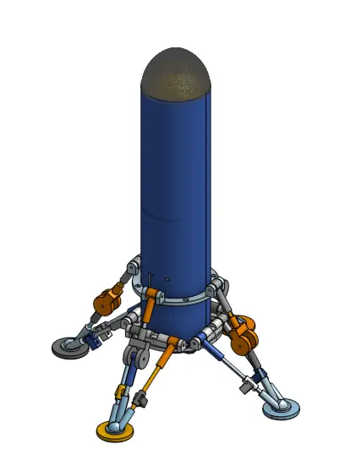
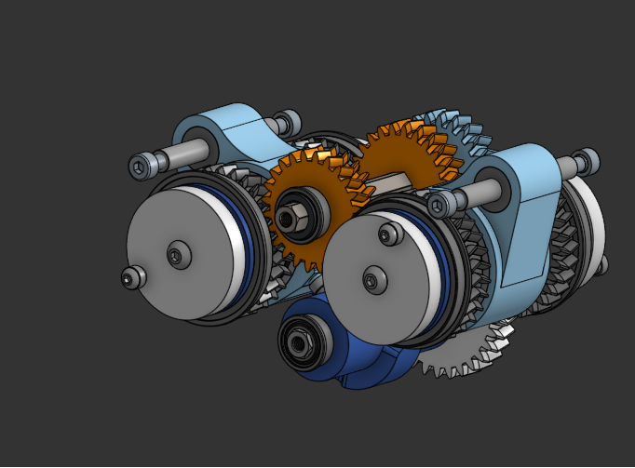
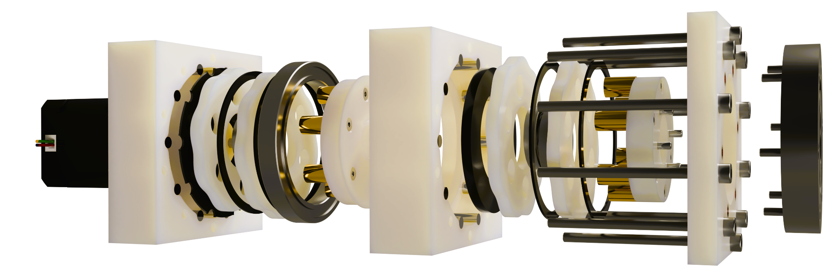
Project highlights: aerospace & hardware, built by American teenagers
Prometheus: a sub-$600 autonomous wildfire-spotting quadcopter: custom flight-controller PCB (KiCad), Onshape chassis, a self-trained vision model. 155 hours. Age 14, California
Silverflame: a thrust-vector-control model rocket designed to land propulsively, Falcon 9 style. Age 16, Washington
Geared reversible CVT: a fully geared, bi-directional continuously variable transmission; 202 hours of mechanical design. Age 16, California
Miniature Mars Rover: printable and published for anyone to build. Age 14, California
SpaceMount: an open-source astrophotography GoTo mount. Age 17, Idaho
Notes:
All projects are on stardance.hackclub.com; hours are tracked with Hackatime.

Slide 10
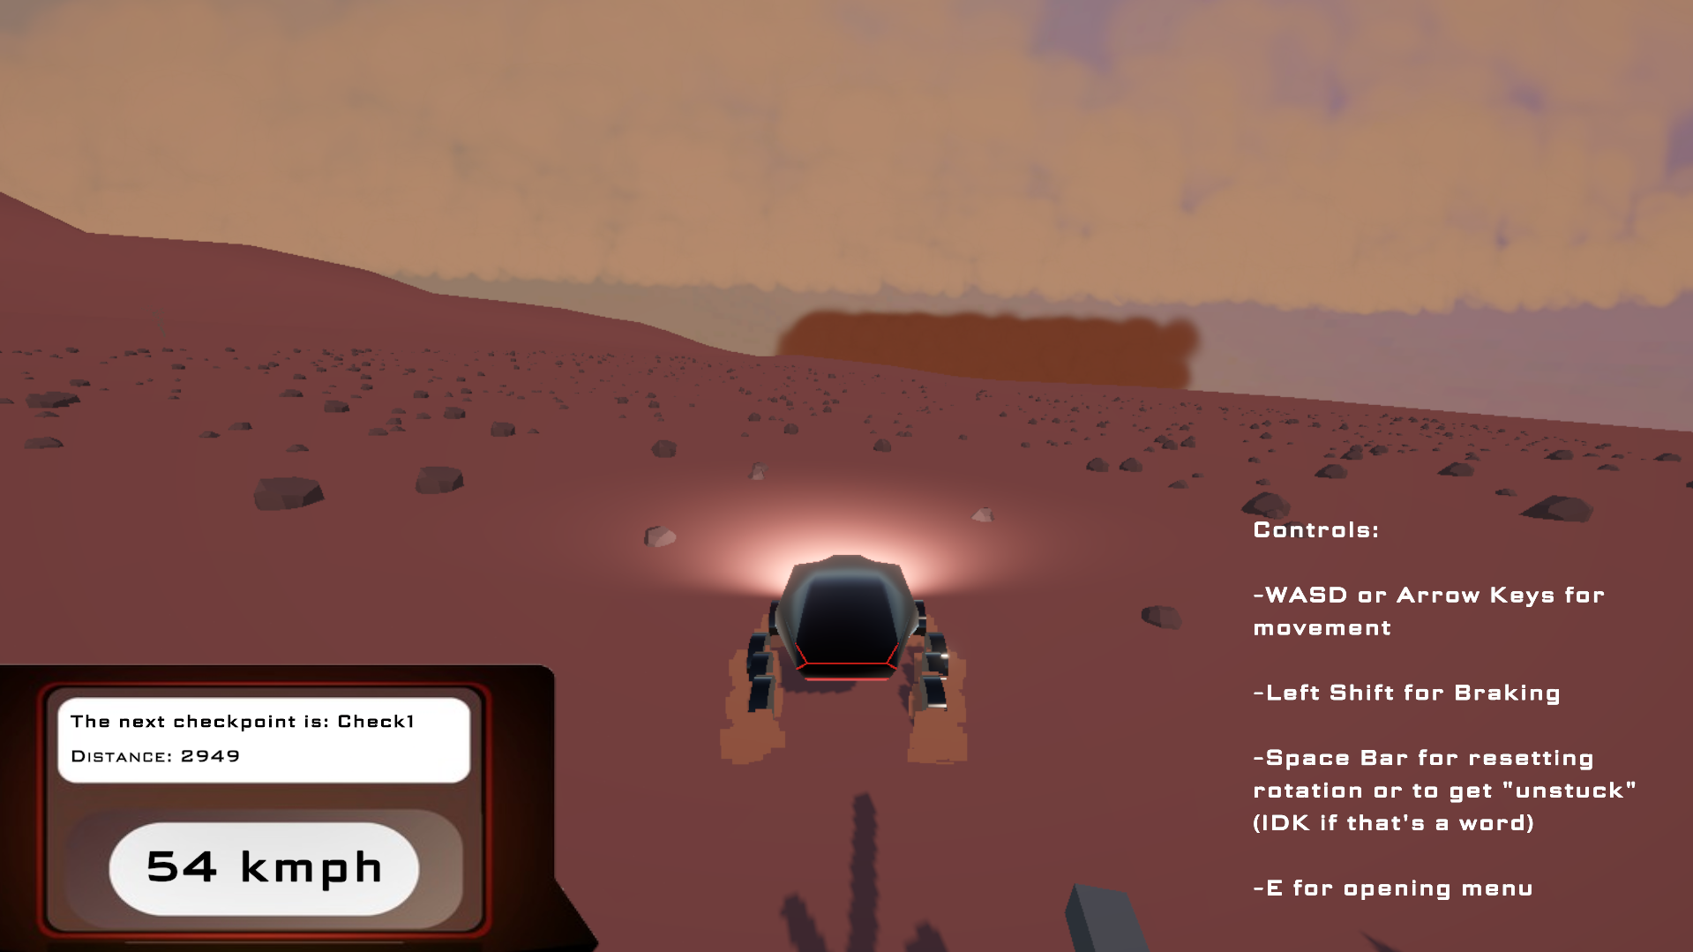
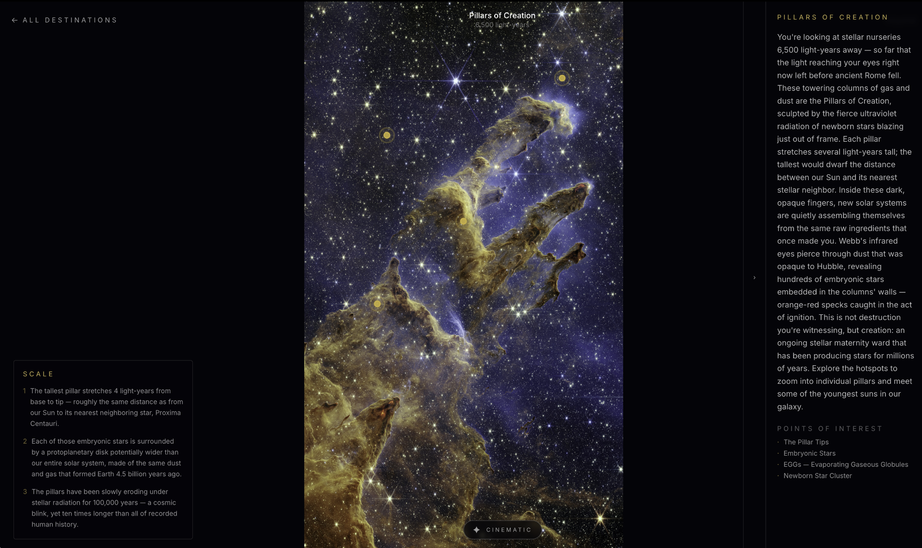

Projects built with open source NASA data from around the world
Orbital Eye: an ISS and satellite pass predictor. Age 16, India
SpaceGuessr: GeoGuessr, but with real NASA imagery. Age 15, Germany
Olympus Mons: The Voyage: a rover simulator on real satellite height maps of Mars. Age 14, United Arab Emirates
Skywritten: an “astronomical biography” of any date, assembled from four NASA archives. Age 17, Bangladesh
Eschatia: a live James Webb Space Telescope archive explorer. Age 16, California
KesslerEdge: an orbital physics simulation for autonomous debris avoidance, top 4%. Age 17, New York
Notes:
All projects are on stardance.hackclub.com. About 2,800 of the projects started in Stardance are space-themed (keyword match on titles and descriptions), from 2,592 teens in 111 countries.

Slide 11
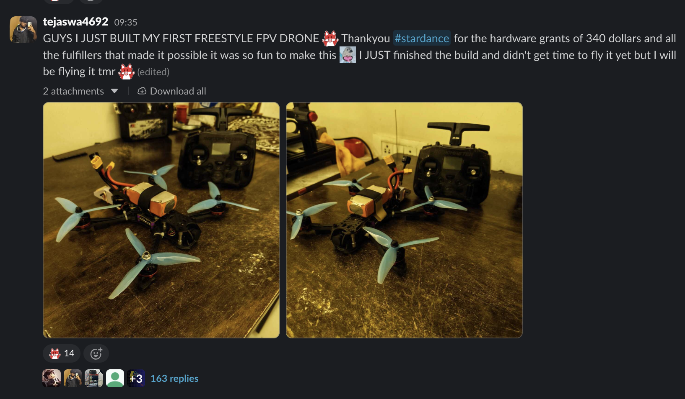
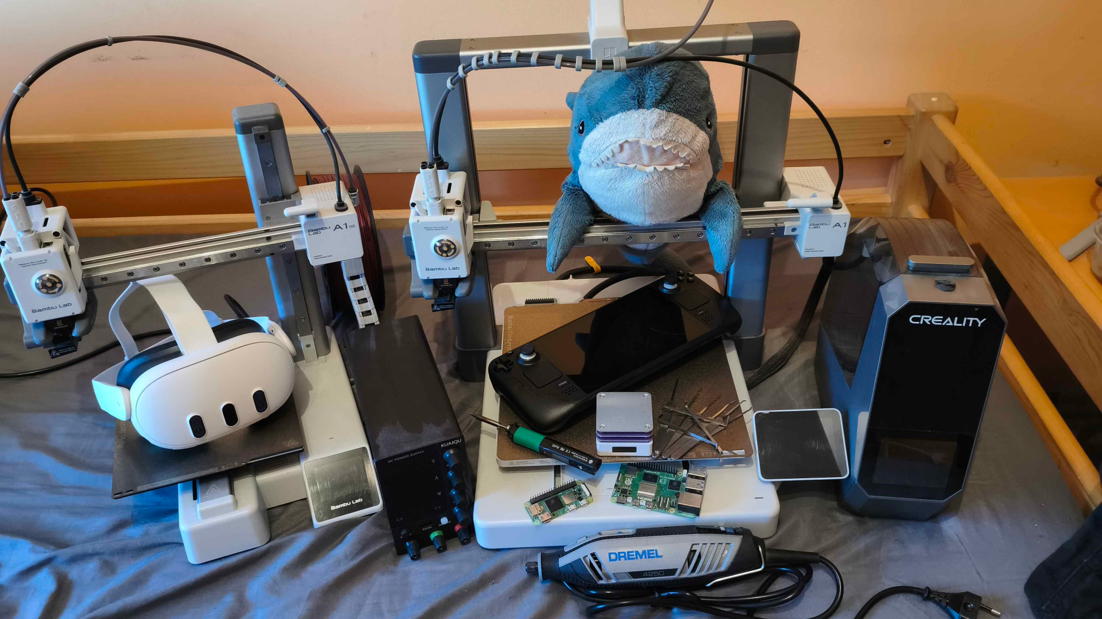
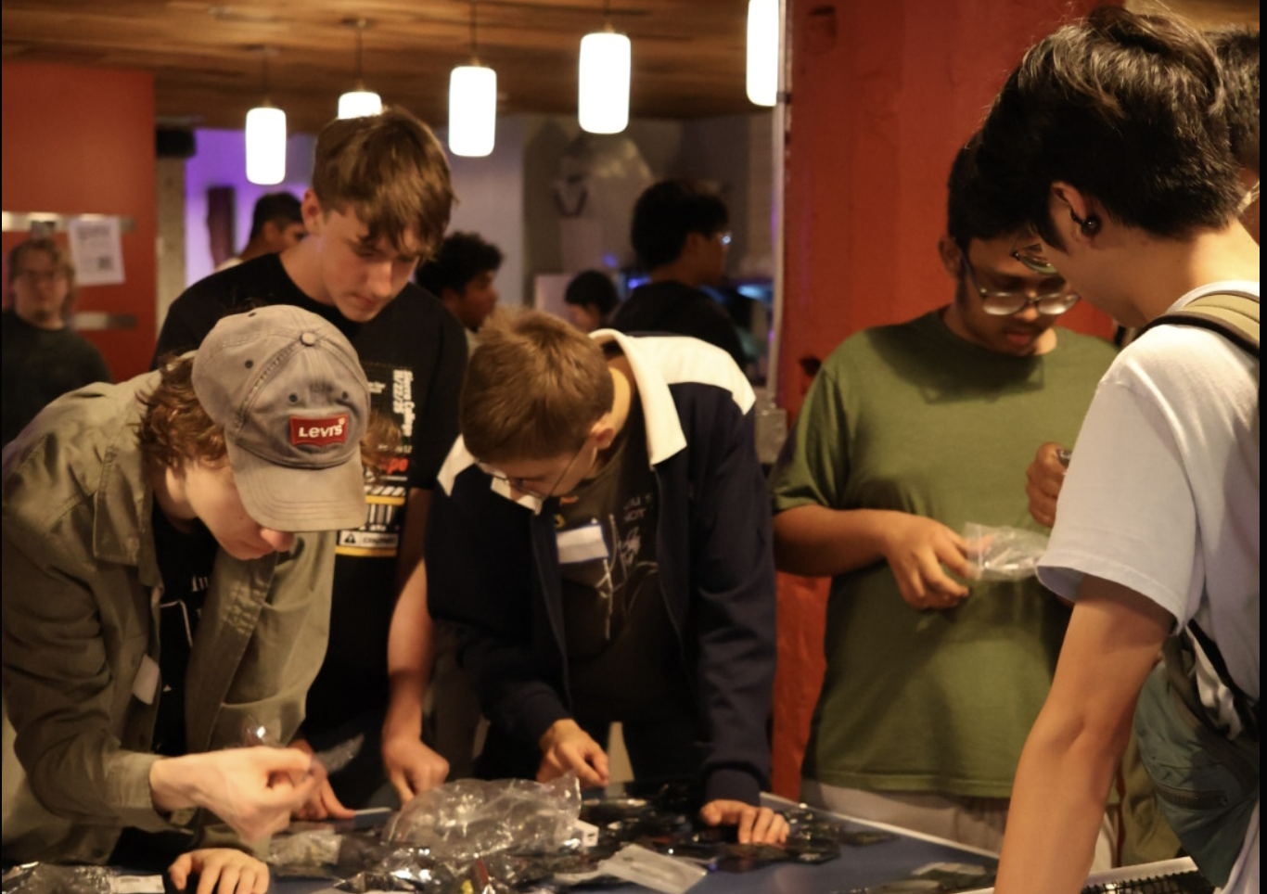
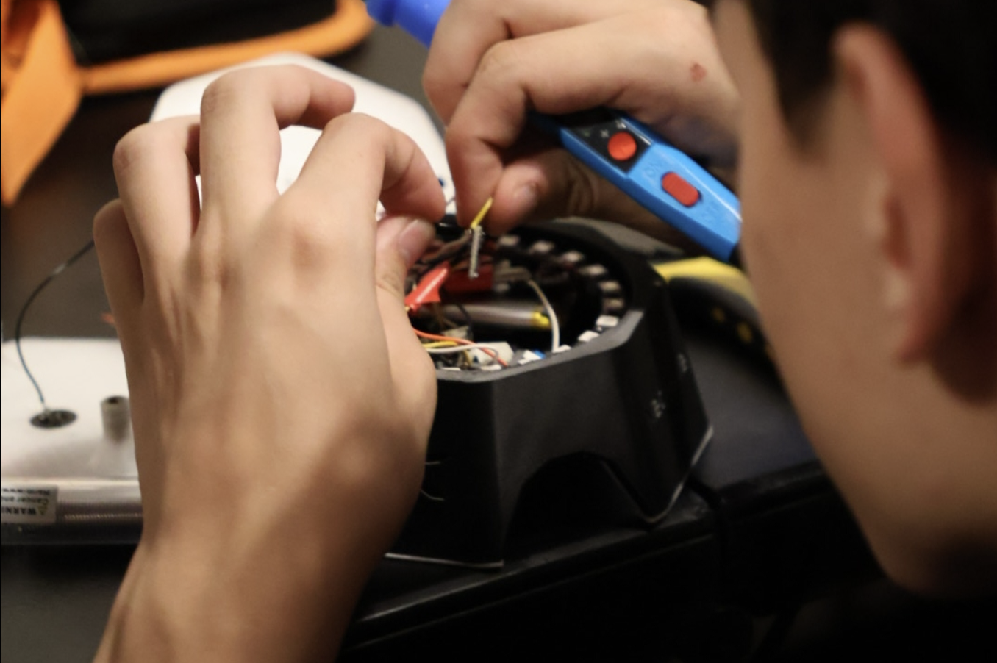
Turning teenagers’ bedrooms into makerspaces
15,900 hardware projects created since the start of Stardance.
$142,783 worth of micro grants given to teenagers in 71 countries.
$52,028 of that went to American teens in 31 states.
18,213 prize items delivered to 7,377 teens: 3D printers, Raspberry Pis, soldering irons, PCB and 3D-printing credits, keyboards, etc.
Outpost: 130 teens flown to a week-long “Manufactured in America” hardware hackathon in San Mateo, CA (July 14–20).
Notes:
Hardware grants: 1,545 approved grants to 684 teens in 71 countries; 446 grants to 229 US teens in 31 states. Prize items: fulfilled shop orders (15,477 orders, 18,213 items).

Slide 12
Thank you for helping change the lives of teenagers across the world!
Hack Club · hackclub.com · stardance.hackclub.com
Contact: Deven Jadhav (deven@hackclub.com), Chief of Staff, Programs
Notes:
Contact: Deven Jadhav, deven@hackclub.com.

Slide 13
We asked teenagers what they thought of Stardance…
Here’s what they said:
“I’ve always been fascinated by space, and I had been imagining a way to explore planets, moons, and missions interactively. Stardance gave me the perfect reason to stop planning and start building.” Age 14, India
“I had no idea how to code, write a readme, or create a repository before this summer, and after the first night that I had finally shipped my first project, I felt tremendously proud. I just wanted to say that I am in absolute awe in what I was able to accomplish because of this program and thank you for that opportunity!!” Age 16, California
“as someone who wants to be an engineer more than anything it’s very inspiring to see that not only are there so many people my age interested in this stuff but also that there are people that are older than us looking out for the next generation and helping us bring our ideas to life. thank you guys so much” Age 16, Nevada
“So far I like Stardance, and I really love that you partnered with NASA because I want to be an aerospace engineer someday.” Age 14, Colorado
“he is so inspiring ngl, he just made me feel more excited about astronomy than anyone ever has.” Age 15, India, after Dr. Jim Green’s AMA
“Y’all are the best! Please do another space themed challenge soon, I love space!” Georgia
Notes:
Quotes are verbatim from the Stardance feedback surveys and the Hack Club Slack, lightly edited for spelling, and attributed by age and state or country only.

